Slide 1
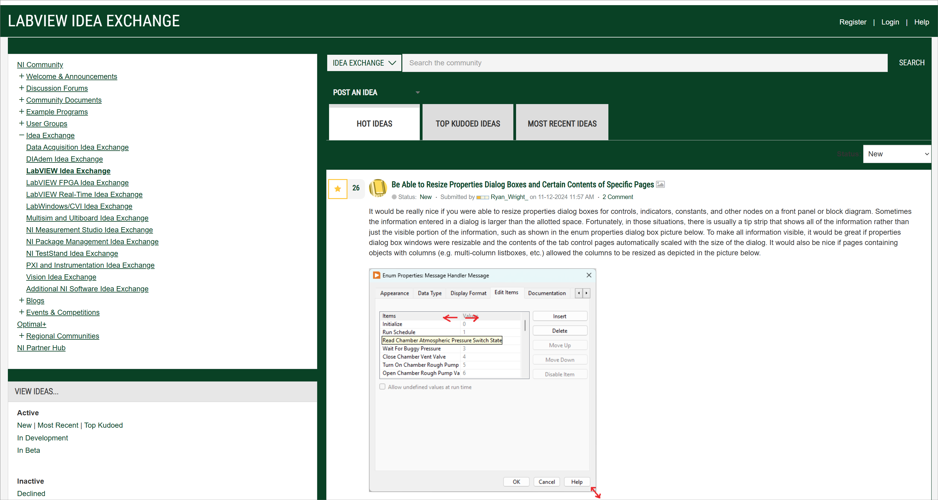
The Best Bang-for-the-Buck Ideas on the LabVIEW Idea Exchange
Screenshot: LabVIEW Idea Exchange Homepage
Event: Midlands LabVIEW User Group (MLUG) (Cheltenham, UK)
Date: Wednesday, 26 February 2025 This presentation is available at: https://github.com/RobustoSystems/TheBestBang-for-the-BuckLabVIEWIdeas

Slide 2
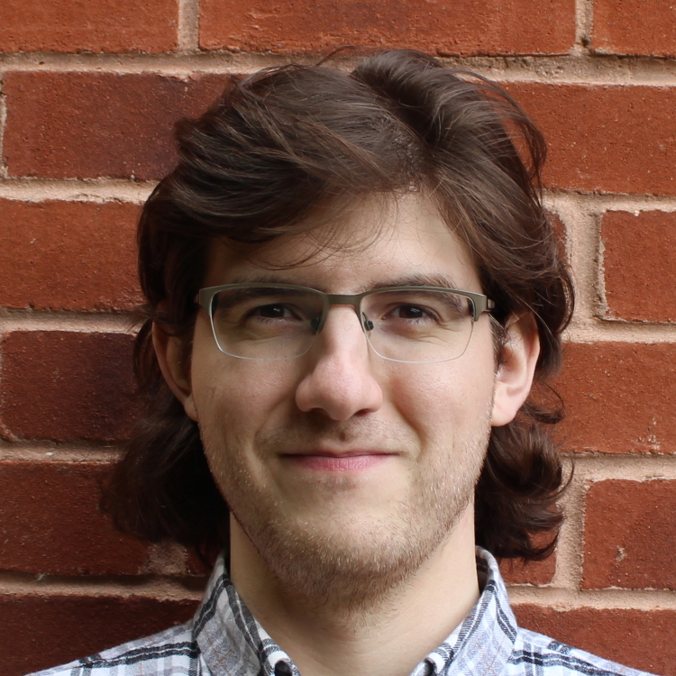


Presenter
Petru Tarabuta MEng MIET | Test System Engineer
Contact Details
Email: petru@robustosystems.com
Tel: 01452 452 165
Robusto Systems Ltd (UK)
www.robustosystems.com
Notes:
I am originally from Romania. I went to The University of Sheffield and have lived and worked in the UK ever since. I am helping customers implement test, measurement, and control systems through my company, Robusto Systems.
It is an honour and a pleasure to attend and present at the Midlands LabVIEW User Group.
Contact Details
Petru Tarabuta MEng MIET CLA CTD CPI | Test System Engineer
Robusto Systems Ltd
petru@robustosystems.com
01452 452 165
www.robustosystems.com

Slide 3
This presentation will discuss
Some of the best bang-for-the-buck LabVIEW ideas
LabVIEW Idea = idea posted on the LabVIEW Idea Exchange (https://forums.ni.com/t5/LabVIEW-Idea-Exchange/idb-p/labviewideas)
A high bang-for-the-buck idea is one that provides a relatively large benefit for a relatively small amount of effort.
Each idea has a bang-for-the-buck metric. This metrics can also be referred to as the benefit-to-effort ratio.
The higher the benefit-to-effort ratio, the better.
Measuring the benefit-to-effort ratio is virtually impossible, due to it being virtually impossible to measure the benefit to the LabVIEW community of a given feature. Nevertheless, the benefit-to-effort ratio can be estimated (by estimating the benefit to the community and separately the implementation effort). This can be done with a reasonable degree of accuracy.
This presentation will not discuss valuable ideas that are difficult to implement.
Dark mode for LabVIEW IDE: https://forums.ni.com/t5/LabVIEW-Idea-Exchange/Dark-mode-for-LabVIEW-IDE/idi-p/3924494
Add Intellisense support to the property node: https://forums.ni.com/t5/LabVIEW-Idea-Exchange/Add-Intellisense-support-to-the-property-node/idi-p/1540954
All windows should be resizable: https://forums.ni.com/t5/LabVIEW-Idea-Exchange/All-windows-should-be-resizable/idi-p/1608142

Slide 4
Purpose
To popularise several LabVIEW ideas that may not be widely known.
To promote the LabVIEW Idea Exchange as a learning tool
Carefully reading the LabVIEW ideas and their associated comments, and even contributing with comments of our own, can be a fantastic learning experience.
In the event that one or more people from NI will watch this presentation (especially people that are part of the LabVIEW R&D team or who are in direct contact with the team), to provide a gentle nudge towards having more LabVIEW ideas implemented in each new LabVIEW version.
To serve as a data point that the LabVIEW Idea Exchange is important, it does matter, and that we (professional LabVIEW programmers) care about it and wish to see more ideas being implemented.

Slide 5
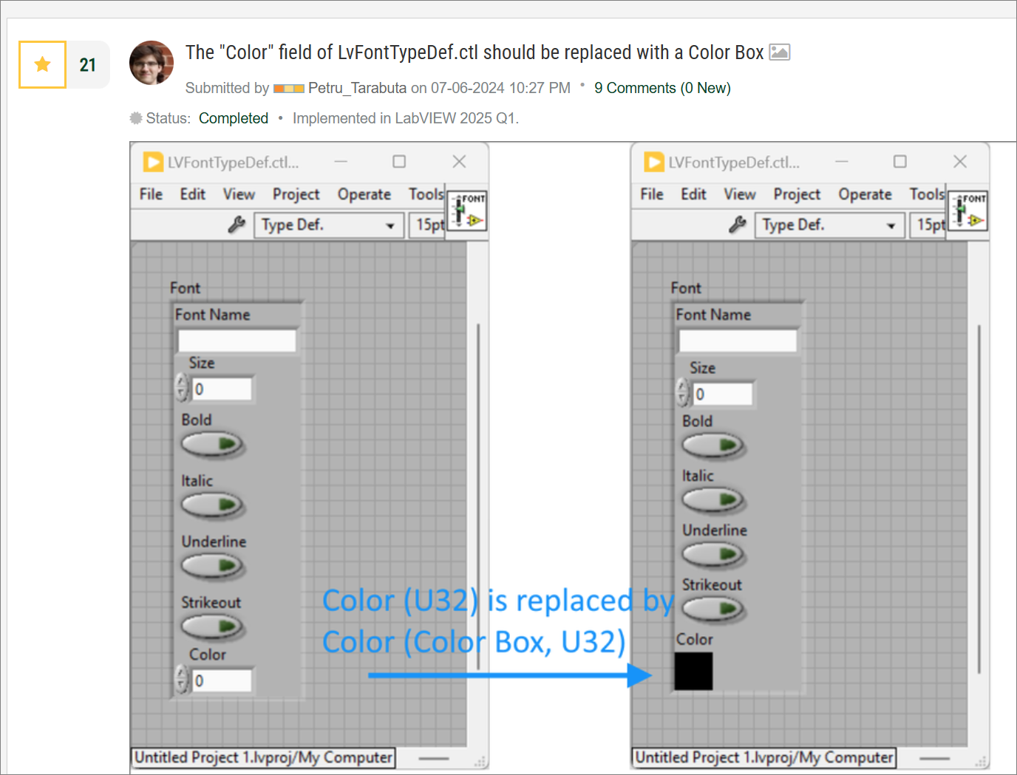
Purpose
To take advantage of the renewed interest that NI has shown recently in the Idea Exchange.
For example, the following idea was implemented in LabVIEW 2025 Q1.

Slide 6
LabVIEW Idea Exchange Statistics
Total number of Ideas with “New” status. | 2,977 ideas
Number of “New” Ideas with at least…
… 300 kudos | 12 ideas (0.4%)
… 200 kudos | 34 ideas (1.1%)
… 100 kudos | 182 ideas (6.1%)
… 50 kudos | 544 ideas (18.3%)
Oldest “New” idea | 06 January 2009
Most recent “New” idea | 30 January 2025
Statistics accurate as of 25 February 2025.

Slide 7
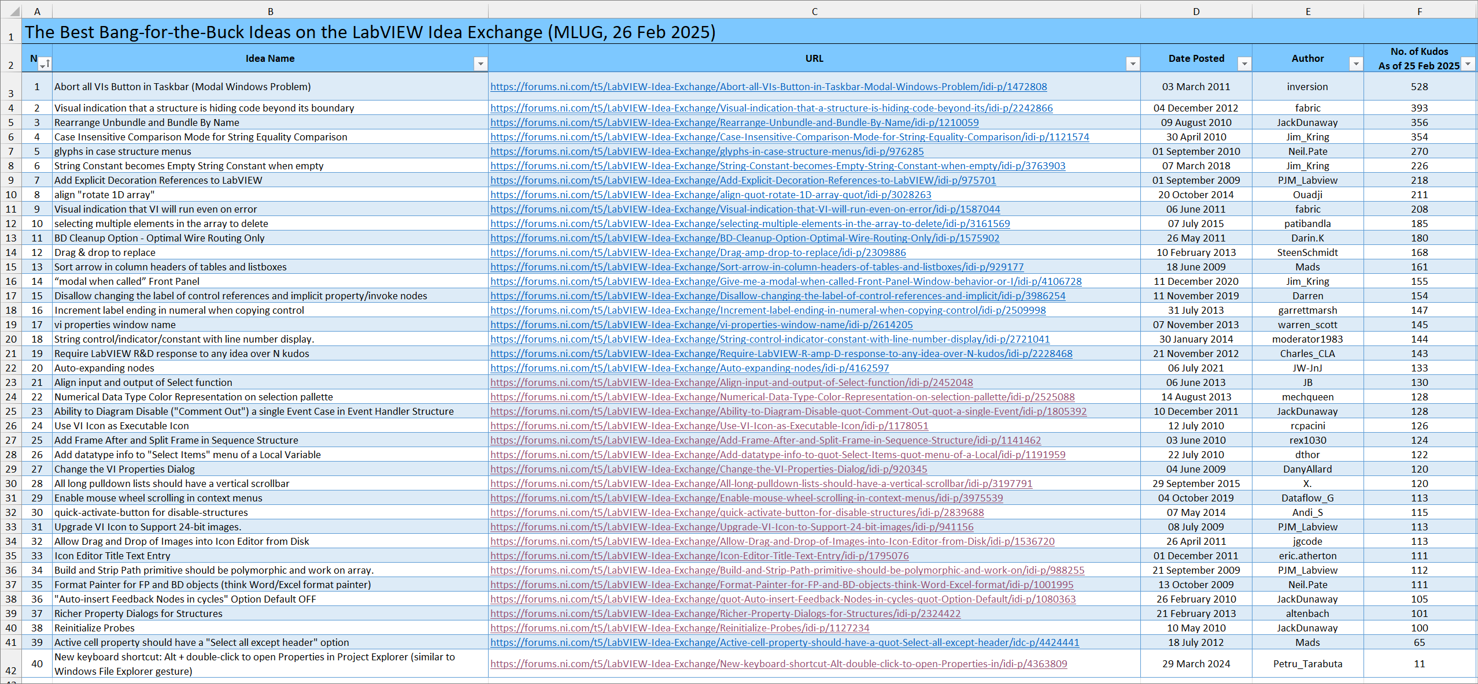
The best bang-for-the-buck ideas
Source: 2025-02-26 The Best Bang-for-the-Buck Ideas on the LabVIEW Idea Exchange (MLUG).xlsx
Notes:
We will likely not have time to cover all 40 ideas.
We will aim to cover at least 10, then as many as we can in the time allocated to this presentation (45 minutes).

Slide 8

Before we finish… an anecdote (part 1)
Once, in high school (age 15 - 18), my cohort’s mathematics teacher asked us a question: “What order should one use to tackle the problems in the upcoming two-hour math test? What is the best order for tackling math questions in a timed test?”
Background: A typical math test would contain several – perhaps up to ten – math questions, usually arranged in order of increasing difficulty. The first problems were usually the easiest. The last problems were usually the hardest. Which problems seemed easy or hard also depended on one’s preparation. The pupils had to provide hand-written, fully worked-out solutions (sometimes pages long for a single problem). No calculators or formula sheets were allowed.
After letting us discuss for a few minutes the teacher provided the answer: “One should start by scanning the whole paper. One should identify the questions that one is most confident in solving quickly. In other words, one should identify the problems that seem easiest to him/her. One should tackle first and foremost these questions. Questions that seem difficult, or with no clear solution, or with no end in sight, should be tackled only after all the easier questions were answered fully”.
Gheorghe Andrei, Mathematics Teacher, “Mircea cel Bătrân” National College, Constanta, Romania

Slide 9
Before we finish… an anecdote (part 2)
This approach has several benefits:
One is more likely to gain all the marks they can gain. By focusing on what you know, what seems easy, you accumulate all the points you can in as little time as possible. This leaves you a finite, well-bounded, amount of time to spend on the hard or esoteric questions, exploring various solutions that may or may not lead to a result.
The key idea is: we should not prioritise tasks that have no clear reward (the hard questions). We should prioritise tasks that have a high likelihood of providing a reward.
Of course, we should do our best to solve the hard problems too, but only after we secured the marks from the “easy” questions.
I believe that most people, myself included, take this approach intuitively in various situations in life. Nevertheless, it was useful for me to hear this advice being spelt out. I have followed it ever since, in virtually all high school and university tests or assessments, and also more broadly in life.

Slide 10
Before we finish… an anecdote (part 3)
How is this relevant to LabVIEW Ideas?
In my humble opinion NI should use the technique described above more often.
Internally, NI should rank the ideas not (just) by the number of kudos, but by the benefit-to-effort ratio.
NI could implement many more of the easy, straight-forward ideas. The easy pickings, the low hanging fruit.
It doesn’t bode well when ideas that take a few programmer days of implementation effort have not been prioritised 15 years after they were proposed.
It would be fantastic to see NI implement 5 to 10 of these low-hanging-fruit ideas in each new LabVIEW version (each 6 months). This will slowly clear the backlog of good ideas, and will prove to the community that NI is listening and is doing everything they can to improve LabVIEW.

Slide 11
Resources
GitHub repository: https://github.com/RobustoSystems/TheBestBang-for-the-BuckLabVIEWIdeas
Contains this PowerPoint presentation
Contains the 2025-02-26 The Best Bang-for-the-Buck Ideas on the LabVIEW Idea Exchange (MLUG).xlsx Excel file.

Slide 12
Thank you!
Are there any questions?

